Slide 1
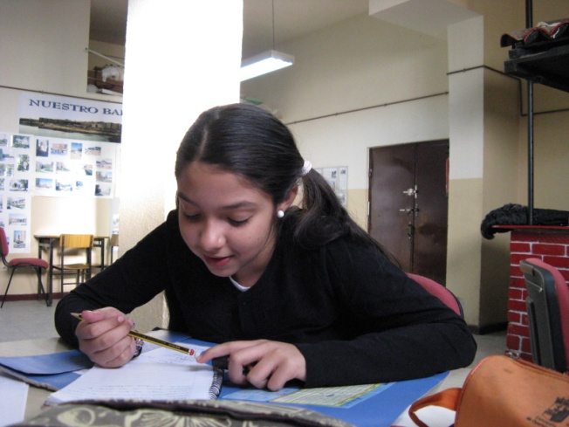
PROMOCIONA Programme
ESF Fight against Discrimination OP 2007-2013 - Spain

Slide 2
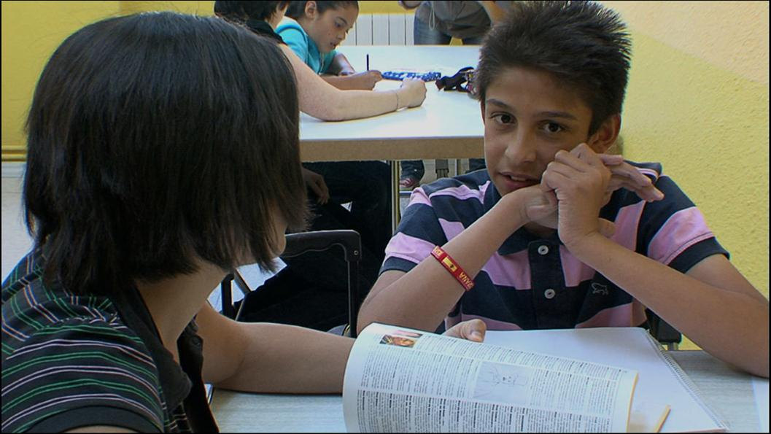
PROMOCIONA Programme: Educational support and guidance programme for Roma youth and their families
Executed by: Fundación Secretariado Gitano (non-profit social organisation)

Slide 3
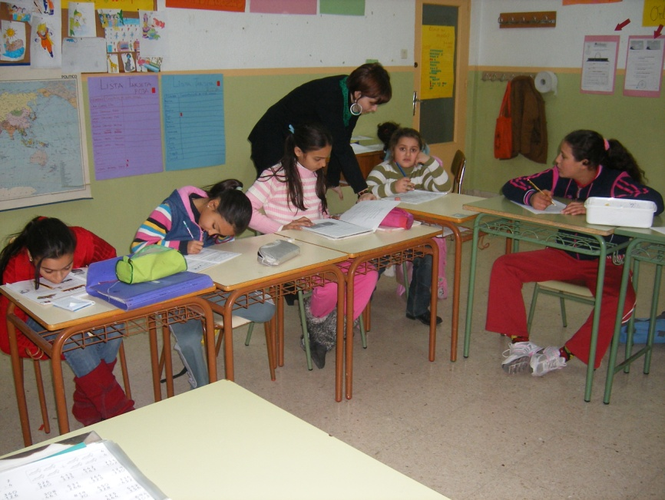
RATIONALE
FSG has been implementing since 2000 the ACCEDER programme aiming at the access of the Roma community to the labour market
In 2005 FSG made a research on “Roma population and employment”. It confirmed that the low academic level of the Roma has a profound effect on all aspects of employment and occupation (low qualification, instability, underemployment, unemployment).
For the programming period 2007-2013 ACCEDER programme incorporated specific actions for Roma education to increase the academic success of the Roma.
ACCEDER = Employment + Education

Slide 4
Multi-Regional Operational Programme
Fight Against Discrimination 2007-2013
European Social Fund

Slide 5
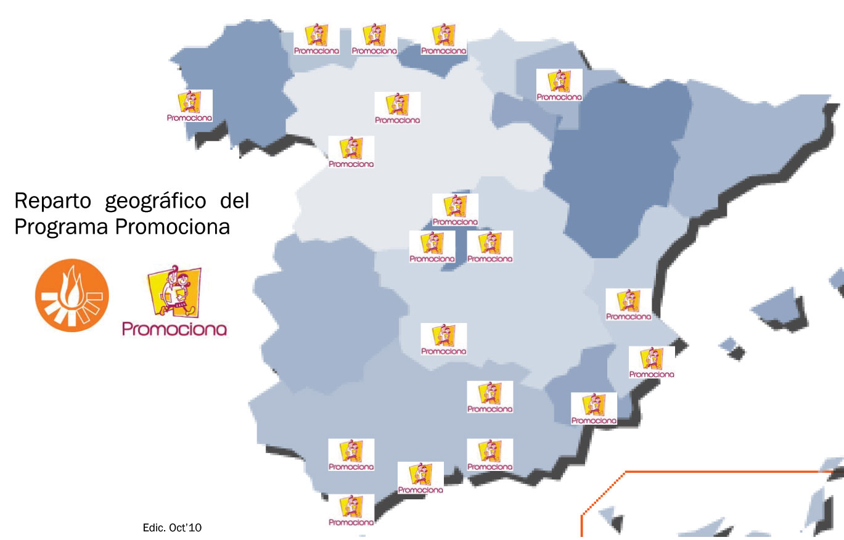
The Programme started in 2008 as a Pilot project with activities in 4 cities
It is currently implemented in 27 cities
2010-2011
12 Regions.
27 Cities

Slide 6
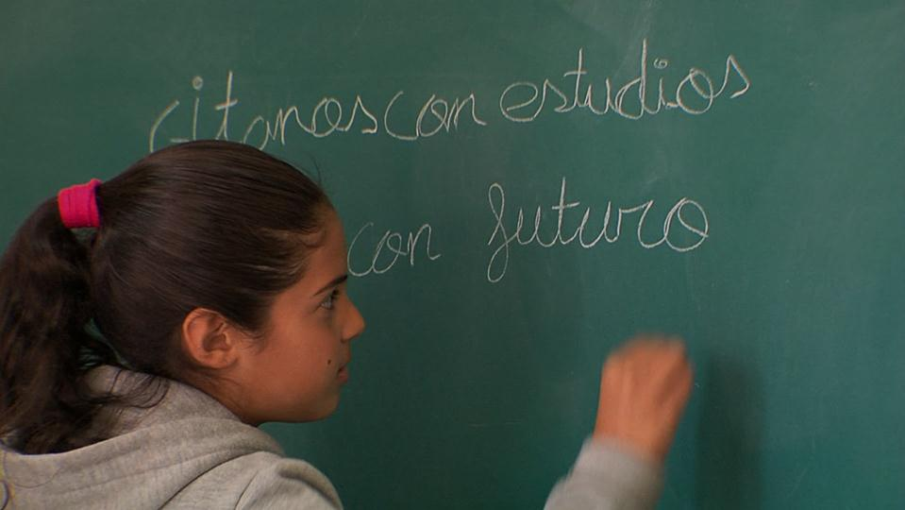
OVERALL OBJECTIVE
PROMOCIONA Programme Seeks to promote the educational mainstreaming of Roma students with a view to achieving higher academic standards at the end of primary education and throughout the compulsory secondary level of education and to promote continued middle and/or higher studies and vocational training.

Slide 7
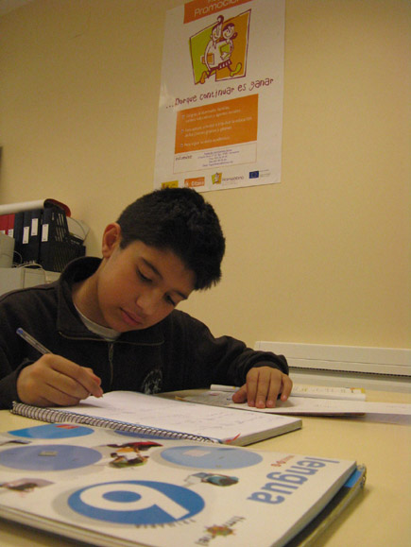
SPECIFIC OBJECTIVES
To facilitate the transition between Primary and Compulsory Secondary Education, permanence in the educational system and advancement on to higher studies.
To generate and enhance the conditions needed to achieve academic success, specially within the Roma community through work with different stakeholders.

Slide 8
THE PROCESS
INDIVIDUAL LEVEL
GROUP LEVEL
SOCIAL-COMMUNITY LEVEL

Slide 9
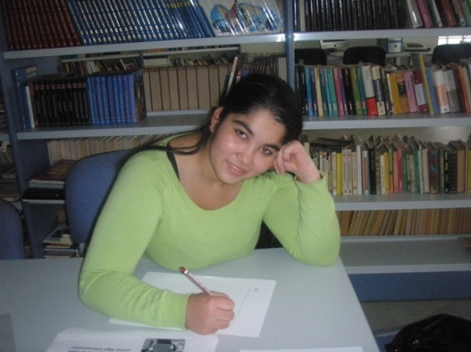
ACTORS
Roma students and their families (in final stages of primary education and in compulsory secondary schooling).
Schools and joint work with teachers.
Other agents, resources and services involved in education.

Slide 10
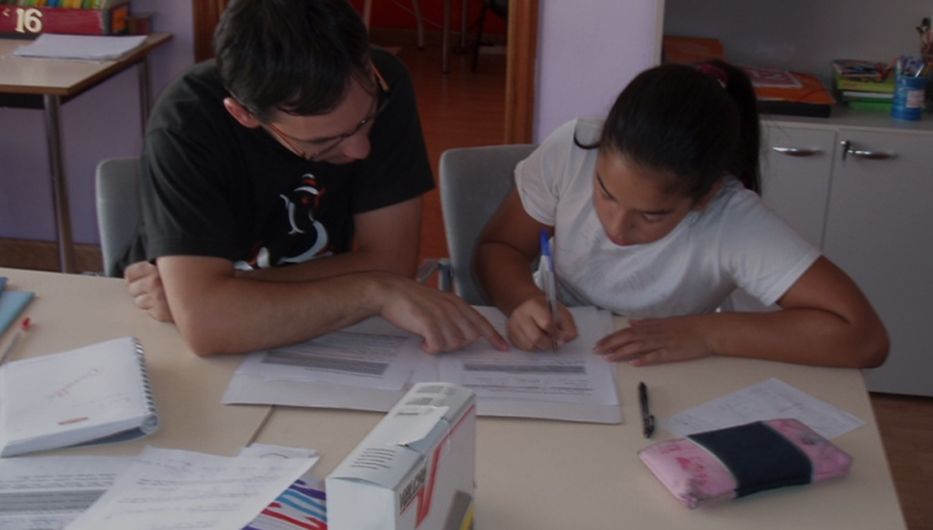
PRIORITY ACTIONS
Individual level: Individualized Intervention Plan with individualized tutoring and counseling sessions.
Group level: The Promociona Classrooms. Academic support and reinforcement, focused on the acquisition of learning habits, school rhythms and rules and the continuation and permanence in the educational system.
Social-community level: focusing on the environment and the social agents close to students and schools .

Slide 11
STAGES
Dissemination and recruitment
Selection of students
Reception and diagnosis
Monitoring and Evaluation
INTERVENTION
Design of the Individualized Intervention Plan

Slide 12
INTERVENTION
Individualized educational counselling
- Students and their Families
Group actions
- Promociona classrooms
- Other actions
Coordination with schools
Coordination with other agents and services

Slide 13
HUMAN RESOURCES
Educational Counselors.
Specialised staff in small group school support sessions: Promociona Classrooms.
Coordinators.

Slide 14
CURRENT PROGRAMME’S DATA 2010-2011
REGIONS | Nº CENTRES | Nº FAMILIES | Nº STUDENTS
Andalucía | 88 | 339 | 375
Asturias | 15 | 29 | 35
Cantabria | 7 | 15 | 15
Castilla La Mancha | 9 | 22 | 27
Castilla y León | 35 | 53 | 58
Cataluña | 3 | 10 | 14
Comunidad Valenciana | 13 | 30 | 35
Extremadura | 5 | 18 | 20
Galicia | 3 | 6 | 8
Madrid | 17 | 37 | 45
Murcia | 14 | 30 | 38
Navarra | 9 | 16 | 22
TOTAL | 218 | 605 | 692

Slide 15
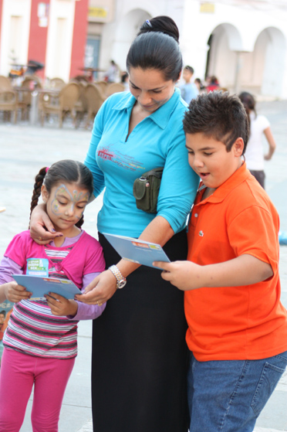
SOME RELEVANT DATA 2010-2011
80% of the students from the last year of Primary Education passed to the first year of Secondary Education.
79% of the students of the last year of Secondary Education have graduated. Most of them will continue to study.

Slide 16
KEYS OF INTERVENTION
Individualised pathways with a community and integrated approach.
Involvement of families and schools (formal agreement)
Strategic approach: selection of those Roma students better positioned to succeed to serve as a reference for the rest.
PROMOCIONA classrooms
Specific tools for monitoring and evaluation (database)
Involvement of a wide set of partners through co-financing (public administrations at local, regional and state level, as well as private organisations)
Complementary actions (research and awareness raising campaign)

Slide 17
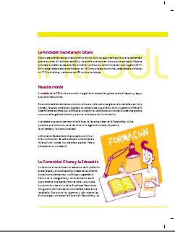
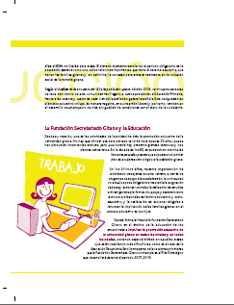
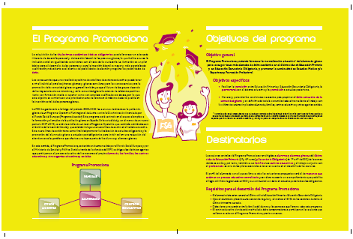
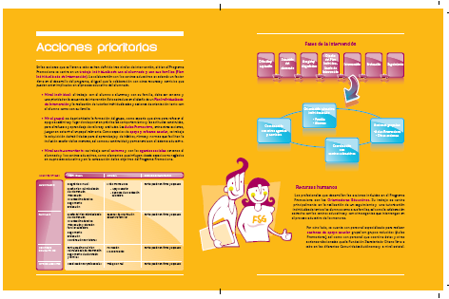
INFORMATIVE BROCHURES
2. PRESENTACIÓN
Available in english at:
http://www.gitanos.org/upload/89/64/AF_Folleto_PROMOCIONA_INGLES.pdf

Slide 18
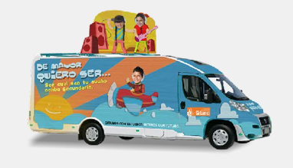
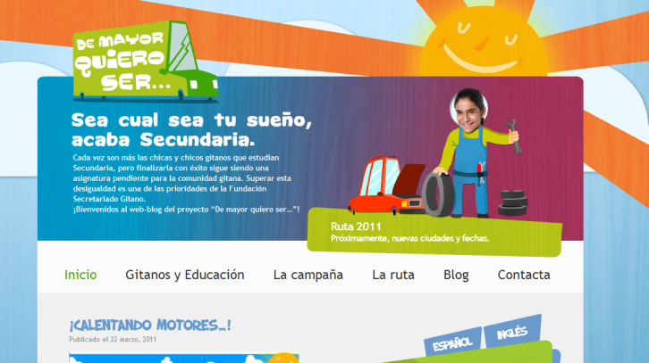
SOCIAL AWARENESS-RAISING CAMPAIGN
ON EDUCATION: 2010-2011
AVAILABLE AT:
http://www.gitanos.org/demayorquieroser/

Slide 19
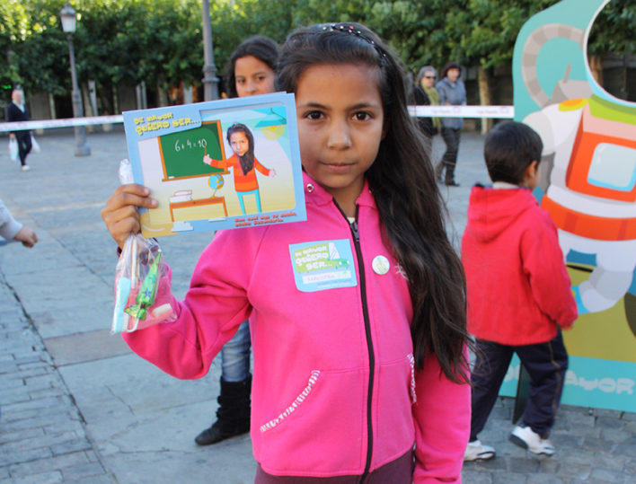
When I grow up I want to be …
OBJECTIVE: To stress the responsability of all public institutions and to get Roma families and youth to value education.

Slide 20
Strategy 2010:
Focus on Roma families 2010-2011- Photo-Van
Focus on key stakeholder Public events
Strategy 2011- 2012:
Focus on Roma
families
Focus on youth
Focus on society

Slide 21
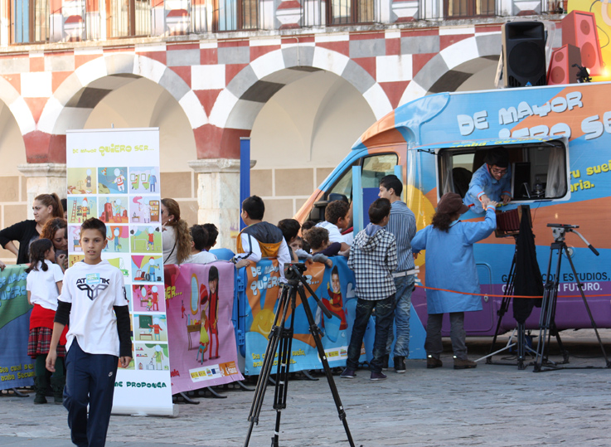
A van (a photographic studio) has travelled around Spain, taking pictures of Roma children.

Slide 22
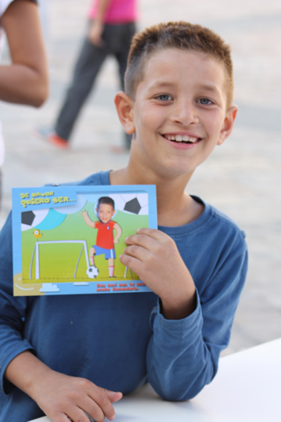
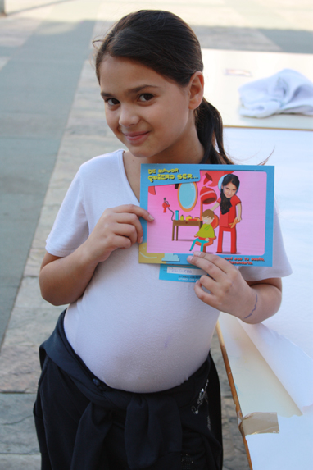
Roma children and their dreams

Slide 23
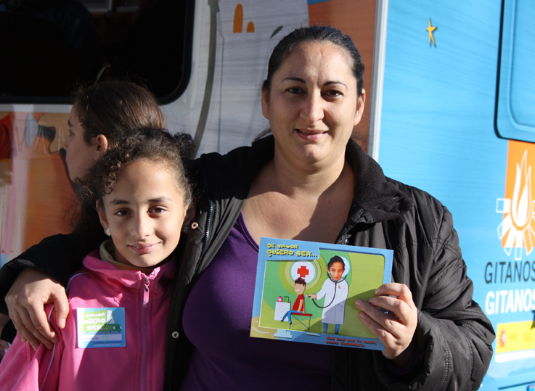
«Whatever your dream may be, finish Secondary School
Roma with an education, Roma with a future»

Slide 24
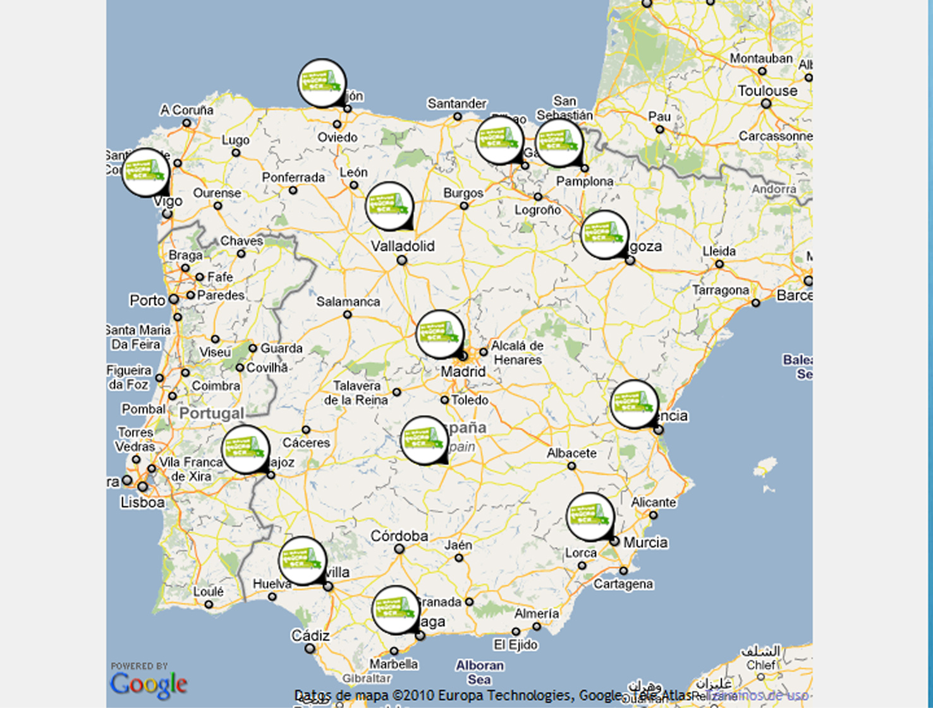
1.400 Roma families (4.200 people) were directly involved
14 different cities in 2010

Slide 25
Awareness materials
Printed material: posters, displays, banner, roll-ups…
Publications: brochures, magazines…

Slide 26
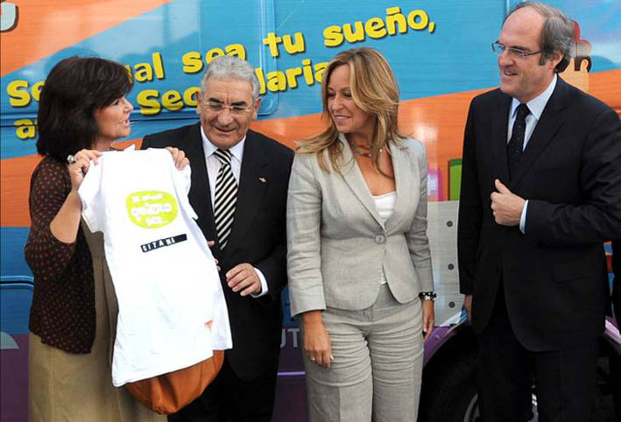
Support by stakeholders
Former Minister of Culture; President of The FSG, Minister of Social Affairs and Minister of Education

Slide 27
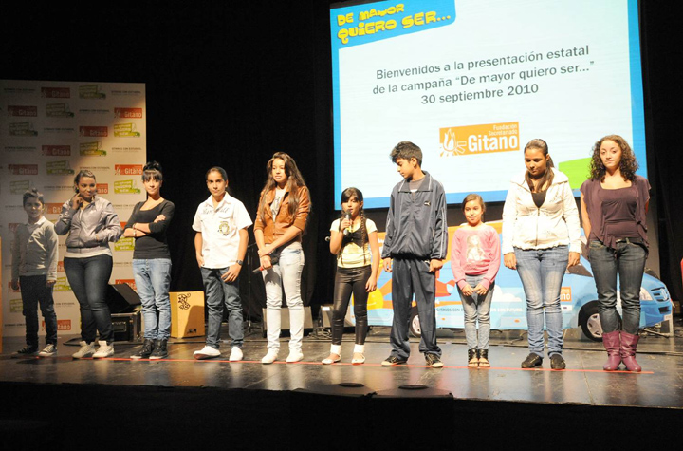
Public events
3.900 People attended the presentations in 2010

Slide 28
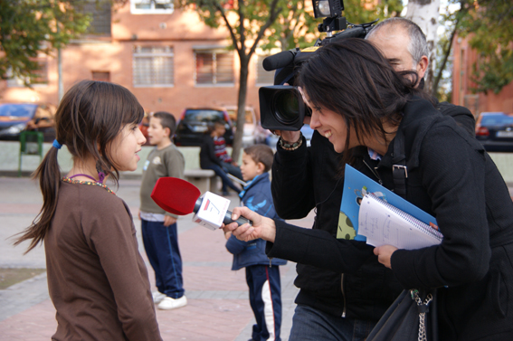
Mass media impact

Slide 29
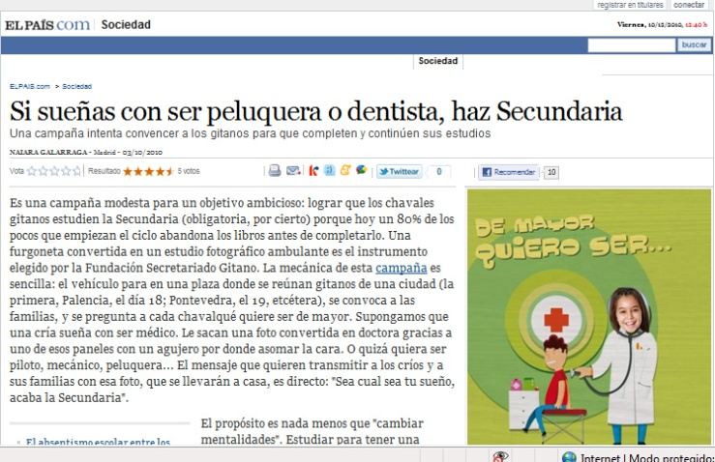
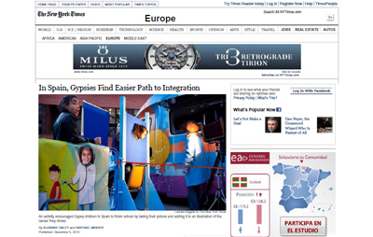
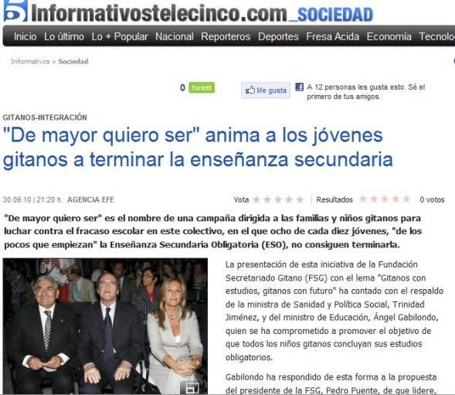
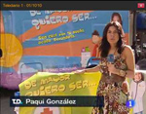
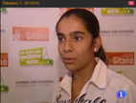
Mass media impact

Slide 30
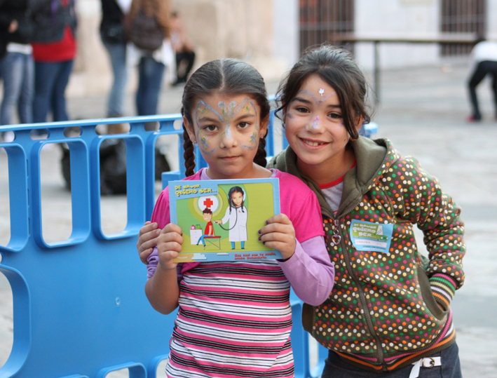

Slide 31
THANK YOU

