Slide 1
Complex programmes promoting social inclusion
Ministry of Human Resources
State Secretariat for Social Inclusion
Hungary
2012

Slide 2
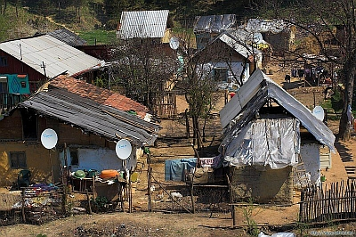
Definition of „segregated residential zone”
Segregated residential zones are geographically compact and separated areas where at least 50% of the working age residents neither have regular income nor have qualification higher than elementary school
According to studies over 1600 segregated residential zones in Hungary, but with various size, population and conditions

Slide 3
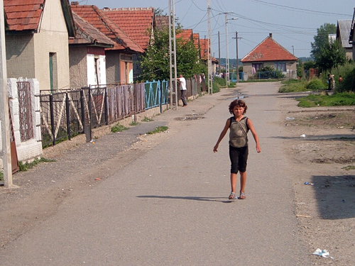
Programmes – in the past and present
From mid- 2000: calls launched annually (national budget)
2010: Trust and activation model programme launched (national budget)
2011: Complex programmes for segregated areas launched (ESF)
2012: Housing programmes to be launched (ERDF)

Slide 4
Programmes implemented between 2005-2009
342 families moved to new flats in integrated residential areas
644 apartments were refurbished and equipped with basic conveniences,
501 persons took part in training
338 persons were employed.

Slide 5
Model program for segregated zone residents
Call launched in 2011. National funds: 410 million HUF (1,5 million EUR)
Sites: 8
Number of persons involved : 600
Number of established community services: 24
Number of refurbished housing units: 100
Requirements from individuals/families participating in the program: Participation in labor market and community programs is mandatory. Regular school and kindergarden attendance is obligatory.
The program facilitates cooperation between local communities and local governments and prepares participants to use Structural Fund resources in the most effective way in order to accelerate social inclusion.

Slide 6
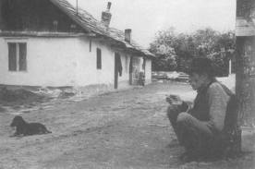
Complex programmes for segregated areas (ESF)
Call launched in 2011.
The complex settlement program aims at segregated residential zones with the potential to be integrated (within the tissue of settlements)
Integrated actions: social, health, education, training, labour market integration and community development related components in order to eliminate disadvantages. Funds available: HUF 5,68 billion (20,3 mullion EUR).
Number of application: over 120
Number of settlements to be supported: 30-50
Programme for housing to be launched in 2013 HUF 1,5 billion (5,36 million EUR).

Slide 7
Basic principles
Mid-term development (intervention) plan (municipality and community level) based on Local situation analysis, mapping individual problems
Complex, integrated actions (outreaching to the whole settlement)
Provision of early intervention and extracurricular development
Training and labour market services
Community development
Health
Social work in the field
Improvement of infrastructure and access to services
Inclusion of relevant stakeholders (including residents)
Individual development plans (for at least 60 percent of the residents aged 3-45 living in segregated zones)
Programme assessment

Slide 8
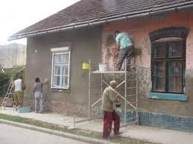
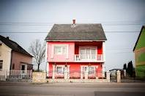
Expected results regarding individuals
Number of persons involved : about 2500
Improved access to services
Higher qualification level of persons involved (at least 75% of active aged individuals with individual development plan)
More people employed
Improved housing conditions (with the involvement of participants in the refurbishing and building activities)

Slide 9
Further plans
In the first half of 2013, residential integration pilot programs are to be launched in three regions (ERDF): Northern Hungary, Northern Great Plain, and Southern Transdanubia
Funds available: 500 million HUF per region (1,78 million EUR)
In 2013 the housing strategy will be devised
2014-20 programming period: devising of settlement rehabilitation programs will continue utilizing previous grant scheme experiences

Slide 10
Challenges in the current and future programming periods
For 2007-13: restricted time and resources – possibility for pilot actions andmainly rehabilitation
For 2014-20: planning of interventions before programme experiences and assessments are available from the previous programming period
For both: harmonization of ESF and ERDF resources and actions

Slide 11
Thank you for your kind attention!
Ministry of Human Resources
State Secretariat for Social Inclusion
Lilla Jutkusz
lilla.jutkusz@emmi.gov.hu

