Slide 1
“…to make a tangible difference to Roma people's lives”
EC Communication 5 April 2011

Slide 2
The EU Agency for Fundamental Rights
Its objective is to provide EU institutions and Member States with assistance and expertise relating to fundamental rights in order to support them when they take measures or formulate courses of action to fully respect fundamental rights.
Its tasks are to:
carry out scientific research and surveys
collect, record, analyse and disseminate relevant objective, reliable and comparable information and data
develop methods and standards to improve the comparability, objectivity and reliability of data at European level

Slide 3
Background to the current work on Roma
Roma Task Force (09/2010): assessing use of EU funding by MSs with regard to Roma integration – results December 2010 found lack of :
know-how and administrative capacity in using EU funds
national co-financing
civil society and Roma communities involvement
official socio-economic data on Roma
rights awareness and evidence of discrimination

Slide 4
EC Communication of April 2011 tasks FRA to…
Expand its research to cover all EU MSs (2012 - 2013)
Collect data regularly across the EU (2012 – 2020)
Assist MSs in developing monitoring tools (2012 – 2020)

Slide 5
EUROPE 2020
2012 - 2020
Working with Member States
to improve monitoring
2018 Roma survey
2013 - 2016
Qualitative research
2019 Secondary data
2014 Roma survey
2013 Secondary data
2011 Roma pilot survey

Slide 6
Roma Pilot Survey
2011

Slide 7
Roma inclusion: the challenge…
Multidimensional issue requiring an integrated approach
poverty
fundamental rights
unemployment social exclusion marginalisation
discrimination anti-gypsyism rights awareness access to justice

Slide 8
The survey…
11 EU-MS < FR, ES, PT, IT, PL, EL, CZ, SK, BG, RO, HU >
Multi-agency operational cooperation with UNDP/WB
sampling + core questionnaire for 5 EU MSs
Total of 22,203 respondents – informing on 84,287 persons
In FR distinction: Gens du voyage – Roma “migrants” (Romanian)
+ Survey of 288 representatives of local authorities
Fieldwork: May – July 2011
Preliminary results presented to EC on December 15, 2011
FRA/UNDP/WB Report to be launched end of May

Slide 9
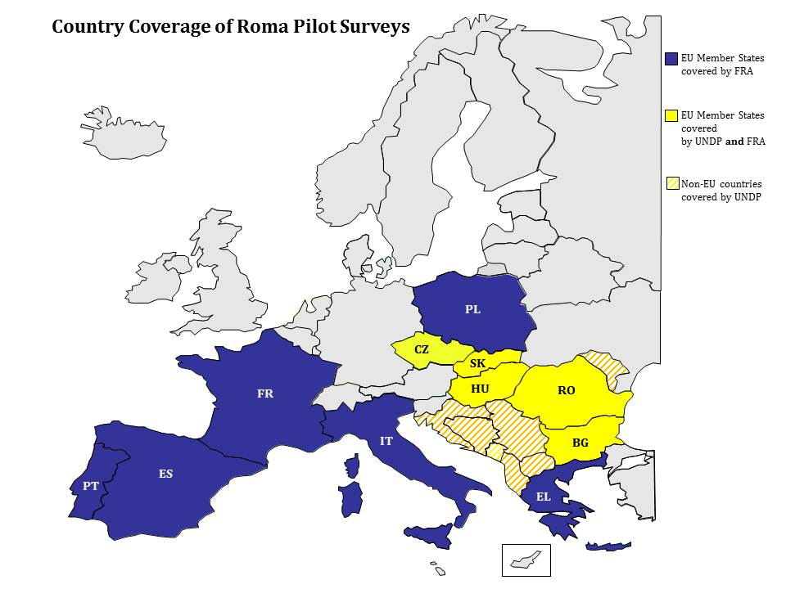

Slide 10
Data on…
Basic socio-economic characteristics
Situation in employment, education, health, housing
Neighbourhood characteristics & infrastructure
Integration, discrimination, rights awareness
Mobility and migration
Active citizenship issues, e.g. voting

Slide 11
Age distribution
FRA + UNDP/WB data base
Roma have higher fertility and mortality rates than non-Roma

Slide 12
: Education On average the proportion of Roma currently in pre-school education or completing general or vocational upper-secondary education is low, especially in comparison to non-Roma.
Issues addressed in the upcoming report
Current pre-school/kindergarten attendance
School attendance during compulsory school age
Completion of at least general or vocational upper-secondary education

Slide 13
Other information on education
Literacy rate
Preschool or kindergarten attendance
Attendance of special school or class
Background of classmates
Circumstances of ending school
Professional qualifications after leaving school
...

Slide 14
: Employment On average the proportion of Roma in paid employment is low, especially in comparison to non-Roma.
Issues addressed in the upcoming report
Paid employment
Self-reported unemployment
Pension
Children working outside the home
Discrimination on grounds of ethnic origin when looking for work

Slide 15
Other information on unemployment
Ever/currently unemployed
Length of current state of unemployment
Received help when unemployed
Registered as unemployed
Currently looking for a job
Reasons for not looking for a job
...

Slide 16
: Health On average Roma declare more often than non-Roma of the same age group to be limited in daily activities due to health reasons
Issues addressed in the upcoming report
Limitations in daily activities such as working, shopping or keeping in contact with other people due to health problems
Medical insurance

Slide 17
Other information on health
Subjective health status
Conditions under which given birth
Unmet need of medical treatment or examination
...

Slide 18
: Housing On average Roma are living often in crowded households that are missing some of the basis amenities, compared to non-Roma.
Issues addressed in the upcoming report
Crowding rate
Lack of basic housing amenities

Slide 19
Other information on housing
Mobility of the households
Official help in finding accommodation
Changes in the neighbourhood infrastructure situation
Ownership
Quality of housing
Repairs
...

Slide 20
: Poverty On average the great majority of Roma households are living on a household income that is below the national poverty line.
Issues addressed in the upcoming report
Persons living in households at risk of poverty
Experience of hunger in Roma households

Slide 21
: Discrimination experiences and rights awareness On average the majority of Roma experienced discrimination based on their ethnic origin in the recent months, and awareness of anti-discrimination legislation in employment is still lacking for many Roma.
Issues addressed in the upcoming report
General discrimination experiences on the ground of ethnic origin
Discrimination experiences when looking for work
Awareness of anti-discrimination legislation in employment

Slide 22
Other information on discrimination and rights awareness
General discrimination on various grounds
Discrimination experiences while
Looking for work
At the workplace
Looking for a house
Health services
Education
Reporting of discrimination experiences
Knowledge of Equality bodies

Slide 23
Migration
Migration history
Migration intentions
Experiences of Roma migrants around Paris

Slide 24
Integration/active citizenship
General and personal socialising in the neighbourhood between Roma and non-Roma
Participation in voluntary work
Awareness of Roma organisations
Knowledge about “Dosta” campaign and Decade of Roma inclusion
Vote in last elections

Slide 25
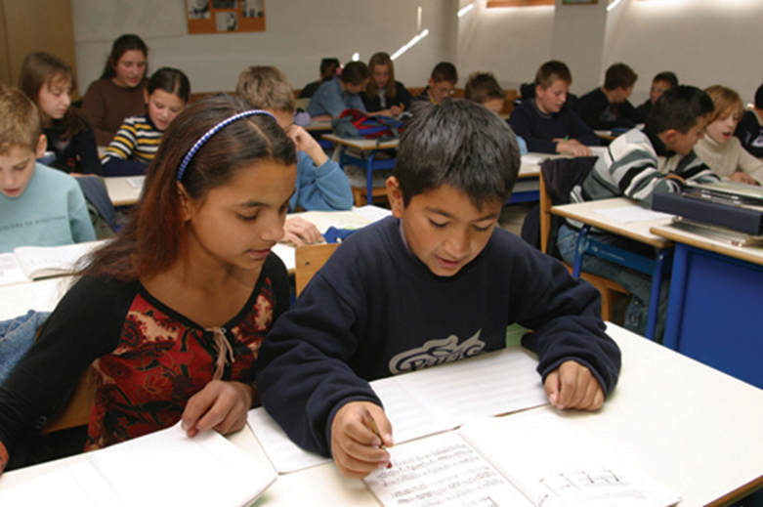
…helping to make a tangible difference to Roma people's lives…
For more information Sabine.Springer@fra.europa.eu Michail.Beis@fra.europa.eu

