Slide 1


GOVERNMENT OFFICE OF THE SLOVAK REPUBLIC
Office of the Plenipotentiary of the SR Government for Roma Communities
Coordinator of horizontal priority Marginalized Roma Communities
Horizontal Priority
Marginalised Roma Communities
EURoma
3-4 May, 2012, Bratislava

Slide 2
GOVERNMENT OFFICE OF THE SLOVAK REPUBLIC
Office of the Plenipotentiary of the SR Government for Roma Communities
Coordinator of horizontal priority Marginalized Roma Communities
Programme period 2007- 2013
Helping disparities among regions diminish is markedly supported by:
NSFR 2007 – 2013 policy
and following NSFR 2007 – 2013 policy also implementation of Horizontal priority Marginalized Roma Communities with the main goal that is increasing employment and educational level of marginalized Roma communities population and improving their standard of living mainly via integrated approach implementation – LSCxA on behalf of 6 operational programmes integration (ROP, OP Env, OP H, OP CaEG, OP Edu and OP EaSI)
2
Notes:
2

Slide 3
GOVERNMENT OFFICE OF THE SLOVAK REPUBLIC
Office of the Plenipotentiary of the SR Government for Roma Communities
Coordinator of horizontal priority Marginalized Roma Communities
MRC support is during the programme period 2007 – 2013 focused on four major areas :
►Education- better educational attainment of MRC (direct support via OP Edu, OP EaSI and indirect support via ROP)
►Employment- higher employment and lower unemployment of MRC (direct support via OP EaSI, OP C&EG and indirect support via OP Env, OP Edu)
►Health – better access to the health care attendance for MRC (direct support via OP H)
►Living- better standard of living and environmental conditions (not proceeded on behalf of HP MRC)
3
Notes:
3

Slide 4
GOVERNMENT OFFICE OF THE SLOVAK REPUBLIC
Office of the Plenipotentiary of the SR Government for Roma Communities
Coordinator of horizontal priority Marginalized Roma Communities
Structure of the coordination of the horizontal priority
Department for Coordination of horizontal priority MRC
Local strategies for integrated approach
MA
ROP
MA
Enviro
MA
Educ
MA
EmSoc
MA
Health
MA
CaEG
4
Notes:
4

Slide 5
GOVERNMENT OFFICE OF THE SLOVAK REPUBLIC
Office of the Plenipotentiary of the SR Government for Roma Communities
Coordinator of horizontal priority Marginalized Roma Communities
Implementation of HP MRC as of April 30th, 2012-projects with a direct support
Operational programme | Number of Contracts - projects | Amount of Contracts in € (EU resources)
Regional operational programme | 42 | 48 751 142,13
OP Environment | 0 | 0
OP Competitivenes and economic growth | 0 | 0
OP Education | 77 | 32 690 884,33
OP Employment and social inclusion | 596 | 93 866 285,22
OP Healthcare | 14 | 7 751 142,13
Total | 729 | 183 115 291,70
5
Notes:
5

Slide 6
GOVERNMENT OFFICE OF THE SLOVAK REPUBLIC
Office of the Plenipotentiary of the SR Government for Roma Communities
Coordinator of horizontal priority Marginalized Roma Communities
Implementation of LSIxA-projects integration in 6 OP
Operational programme | Allocation LSCxA via OP integration (EU resources + state budget) | Contracts-project intents LSCxA (EU resources+state budget) |  | Contracts from allocation
 | € | number | € | %
Regional operational programme | 85 000 000,00 | 0 | 0 | 0
OP Environment | 22 937 163,00 | 0 | 0 | 0
OP Competitivenes and economic growth | 16 470 588,00 | 0 | 0 | 0
OP Education | 17 000 000,00 | 5 | 518 172,65 | 3,04
OP Employment and social inclusion | 26 500 000,00 | 13 | 1 622 091,33 | 6,12
OP Healthcare | 10 000 000,00 | 14 | 9 334 256,31 | 93,34
Total | 177 907 751,00 | 32 | 11 474 520,29 | 6,45
6
Notes:
6

Slide 7
GOVERNMENT OFFICE OF THE SLOVAK REPUBLIC
Office of the Plenipotentiary of the SR Government for Roma Communities
Coordinator of horizontal priority Marginalized Roma Communities
Projects with indirect support of HP MRC
Operational programme | Number of Contracts-projects | Amount of Contracts in € (EU resources)
Regional operational programme | 761 | 589 690 884,33
OP Bratislava region | 6 | 1 951 189,35
OP Environment | 141 | 399 678 157,81
OP Competitivenes and economic growth | 75 | 85 440 216,19
OP Education | 25 | 70 419 393,63
OP Research and development | 19 | 30 775 834,07
OP Employment and social inclusion | 115 | 28 836 775,28
OP Healthcare | 46 | 224 706 904,99
Total | 1 128 | 1 430 826 800,10
7
Notes:
7

Slide 8
GOVERNMENT OFFICE OF THE SLOVAK REPUBLIC
Office of the Plenipotentiary of the SR Government for Roma Communities
Coordinator of horizontal priority Marginalized Roma Communities
Advice based on the current programme period and applicable during the next programme period:
► cross-sectional horizontal priority of MRC:
positives: an independent HP generation means a mile stone in finding a possiblity of solution to the Roma communities issue on behalf of Structural Funds; possibility of its fullfillment in various OP
negatives:misunderstanding replacement of MRC and Romma communities, non-existing proper allocation based on real needs of MRC and not based on possibilities of each OP, non-existing flexibility of variable conditions tailored to the MRC needs (a high need of audit in OP which is an area that is not reachable by the coordinator)
► cross-connection of HP and OP postpones an implementation for more than one year: a call by Office of the Plenipotentiary (3 months) =>applications evaluation in the Office of the Plenipotentiary (3-6 months) =>calls by OP (due to the schedule of MA but from 1-12 months, call 3 months) =>applications evaluation in the office of OP (3-6 months) =>contract signing and project implementation initiation (1-2 months) – total since the project has been delivered to the Office of the Plenipotentiary – 14 up to 32 months
-can we still talk about projects up-to-date? Or about the projects effectiveness?

Slide 9
GOVERNMENT OFFICE OF THE SLOVAK REPUBLIC
Office of the Plenipotentiary of the SR Government for Roma Communities
Coordinator of horizontal priority Marginalized Roma Communities
►specification of the targeted group of HP MRC based on the Map of Roma Communities – insufficient (a high need of update and new data complete) and incorrect (Map of Roma Communities does not provide us with the information about MRC but all settlements with Roma population)
►a need of various OP cross-connection and guarantee of cofinancing with no consideration that the recipients present settlements with low budget and low income from the population (project budget is 100% higher than the municipality budget)
► position of HP MRC coordinator with his competencies is not in accordance with his responsibilities
►fractionalism of the whole allocation in 6 OP has not been a good choice as an effective possibility (variability of cross-connected OP makes an integration and timing of calls schedule complicated; MRC needs then must adopt to the possibilities of OP and strategies of each MA of OP on how to solve the MRC social inclusion in Slovakia)

Slide 10
GOVERNMENT OFFICE OF THE SLOVAK REPUBLIC
Office of the Plenipotentiary of the SR Government for Roma Communities
Coordinator of horizontal priority Marginalized Roma Communities
A possible solution for the next programme period:
► remain with the HP with real impact – „Horizontal priority Roma inclusion (HP RI)“
► generation of independent OP „Marginalized Roma Communities“ with a direct contribution to the HP RI goals approach
Combination of ESF a ERDF resources
Areas of intervention
Only for communities with MRC population
Determine measure of cofinancing reflecting measure of marginalization and applicants type
Cross-connection with projects already implemented from the programme period 2007-2013

Slide 11
GOVERNMENT OFFICE OF THE SLOVAK REPUBLIC
Office of the Plenipotentiary of the SR Government for Roma Communities
Coordinator of horizontal priority Marginalized Roma Communities
Evaluation needed for the next programme period preparation:
  „Specially solution to the problems of marginalized Roma communities is an ideal area to consider effects of the benefits from Structural Funds objectively.
  In order to qualify a real impact of intervention it is undoubtedly necessary to possess appropriate instruments for monitoring and measuring effects. Practically it means to have an accurate and reliable information about the targeted group, or about its conditions which are aimed to be affected.“
  (Ad hoc evaluation HP MRC in 2011 – CA Consulting Associates s.r.o.)
  During the programme period 2007-2013 there has been the ex ante evaluation of OP proceeded though ex ante evaluation of HP MRC has not been proceeded (information based only on Map of Roma Communities). Due to this situation it appears to be a problem to evaluate effects of interventions on MRC in that we are not familiar with the initial criteria of targeted group.
  There is a high need to have an ex ante evaluation of good quality of targeted group to be proceeded during the next programme period.

Slide 12
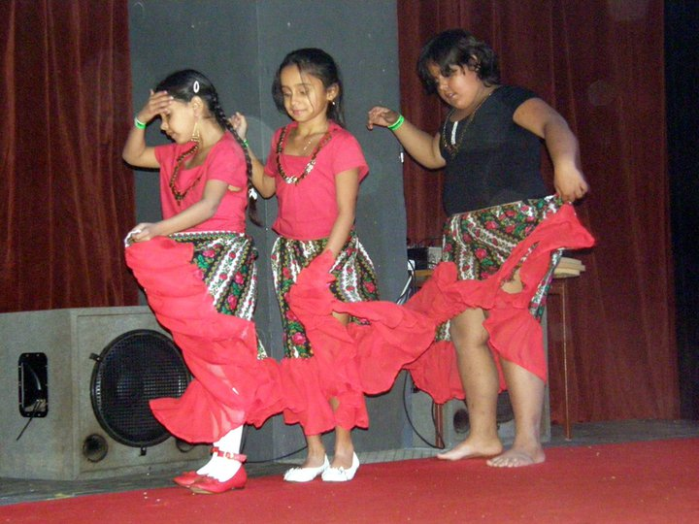
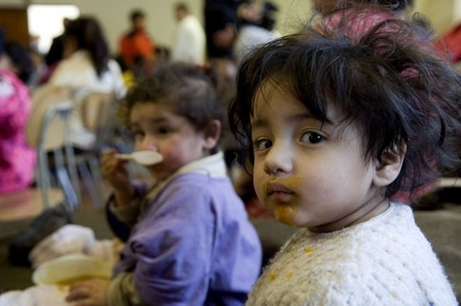
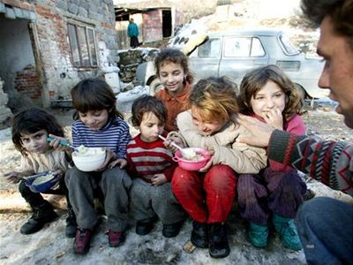


GOVERNMENT OFFICE OF THE SLOVAK REPUBLIC
Office of the Plenipotentiary of the SR Government for Roma Communities
Coordinator of horizontal priority Marginalized Roma Communities
12
Notes:
12

